Slide 1
DRAT! Automated Analysis of Software Licenses
Chris A. Mattmann Chief Architect, Instrument and Science Data Systems Section, NASA JPL Adjunct Associate Professor, USC Director, Apache Software Foundation

Slide 2


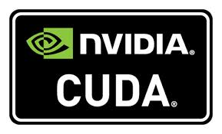



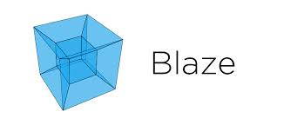




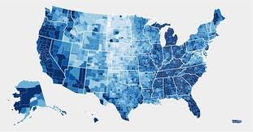
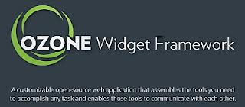


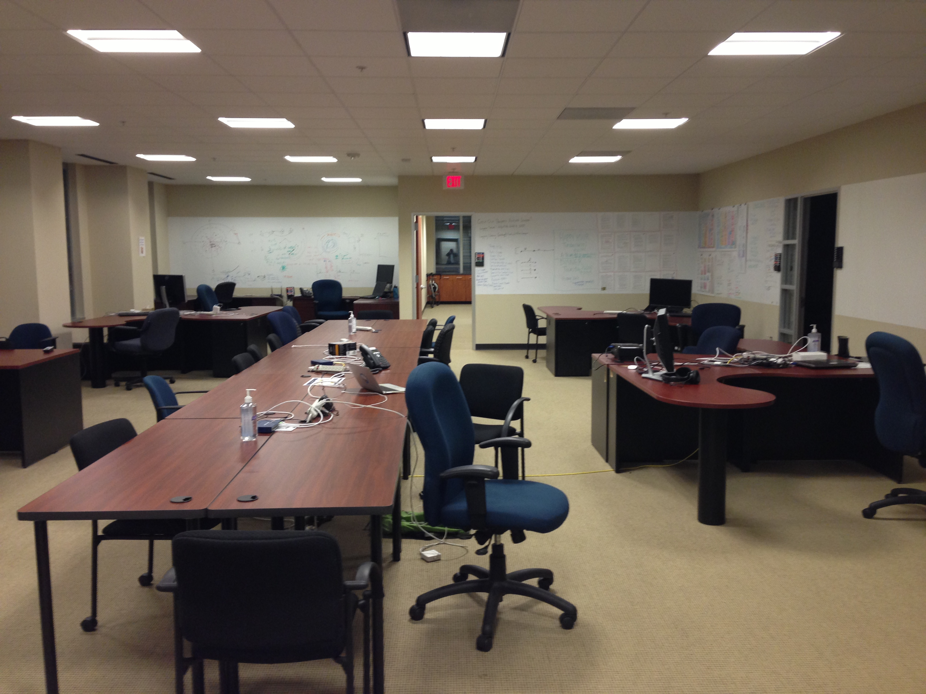

DARPA XDATA
Grab the principals behind the leading infrastructure/viz technologies
Shove them in a tight space
Provide beer coffee and snacks
Provide awesome data and challenges
Provide infrastructure and connectivity
Check in every day and 1x a week
Wall of Shame/Fame
New Challenges Each Week
Midterm Presentations
Peanut Gallery
Make people talk/socialize
Put that all together

Slide 3
XDATA OSS landscape

Slide 4
XDATA OSS
Scenario 1
Performers dev code in their own local repos and occasionally “push” upstream and “pull” downstream
Scenario 2
Canonical repo is XNET Git repo
Scenario 3
Code can be “pushed” upstream to foundations and gold sources of code (and “pulled” periodically)
Scenario 4
Code can be “pushed” & “pulled” from performer repo to foundation

Slide 5
Git code repo analysis
Characterize the Git
Using Tika and also course grained (E. Whyne) using UNIX tools
Run RAT code analysis to produce evaluation and recommendation on license updates

Slide 6
Discoveries about Apache RAT
With over 56K files in XNET many of them binary
RAT job using single JVM and traditional technique is still running 40924:47 and counting
Running targeted RAT jobs is difficult because RAT crawler isn’t customizable by
MIME type
File size, etc.
Only provides white list and black list capability
RAT provides no incremental output
Only get a final report when done

Slide 7
Suggestions for improvement
Incremental output for Apache RAT
https://issues.apache.org/jira/browse/RAT-149
Use Apache Tika to deduce MIME types of code analysis for RAT
That way no need for white/black lists
https://issues.apache.org/jira/browse/RAT-150
Make RAT parallelized using Apache OODT
Make RAT easily integratable into a CI system beyond the Maven plugin (not distributed)

Slide 8
Proposed Architecture

Slide 9
Steps
Ingest Git (or SVN or any) repo into Apache OODT file manager in place
Classify file types here with Apache Tika
Dump File Manager Metadata to Apache Solr for easy analytics and characterization
Use OODT Solr dumper
Kick off M/R style job workflow using Apache OODT
Partition by MIME type (from Tika)
Mapper: RAT on N=100 files of same type in single job dir
Reducer: RAT log combiner

Slide 10
Real Results
Grep/Find characterization
Refinement using Tika

Slide 11
Timing
3 runs of distributed RAT (DRAT?)
M-R style distributed RAT runs to completion
Completes in best case in ~2 hours including all workflow steps
Other single job RAT still running for 3+ weeks on fairly large machine (24+ cores with 2+GB ram per core AMDs)

Slide 12
RAT analysis of Git repo

Slide 13
Analysis conclusions
About 12% of files in XNET Git are ALv2 licensed (expands to 65% when considering 53% more use standards which may be any of the approved OSI licenses which is a superset of the XDATA OSS policy)
Further analysis required on 35% unknown licenses
Will contact teams with further info
By far, the javascript licensed code causes the largest problems for RAT (JS jobs take on average 30-45 mins to complete)
Targeting by mime type and RAT helps RAT complete in a reasonable time and easily integratable into CI system
Will deliver Distributed RAT to Data Tactics for integration into XDATA CI and XNET build process

Slide 14
Motivating EarthCube/Geosciences Example
Computational Infrastructure for Geodynamics
~500K files
~30 or so software projs
Multiple releases
Multiple versions
Long lived model repository with likely ~10s-100Ms LOC code base
Also looked a Penn State Integrated Hydrologic Model (PIHM) from PSU/Duffy
Does the software correctly identify an OSS license?

Slide 15
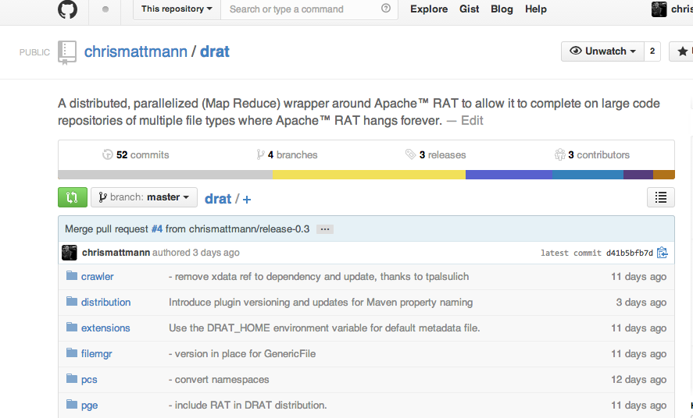
Enter: DRAT
Distributed Release Audit Tool
A Map Reduce version of Apache RAT
Produces reports which identify software license distribution in large code bases
http://github.com/chrismattmann/drat/
http://skc.isi.edu:8088/opsui/

Slide 16
Running DRAT on XDATA
Some comparative analysis
DRAT initially developed on DARPA XDATA project (large ~$100M investment from DARPA in Big Data)
XDATA year 1 results in 24K file Git repository ~10M LOC
RAT unable to analyze XDATA Git repo, so DRAT developed and completes analysis in ~2 hours on a simple Mac Book Pro

Slide 17
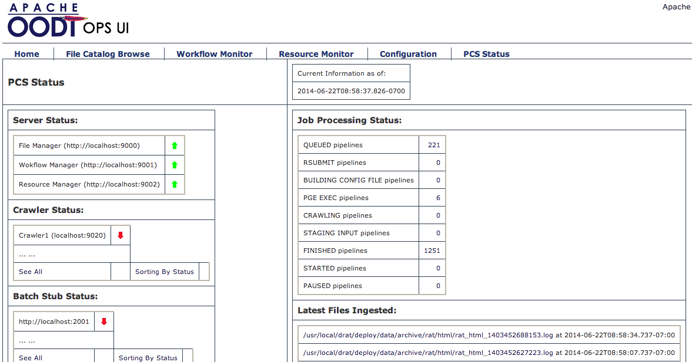
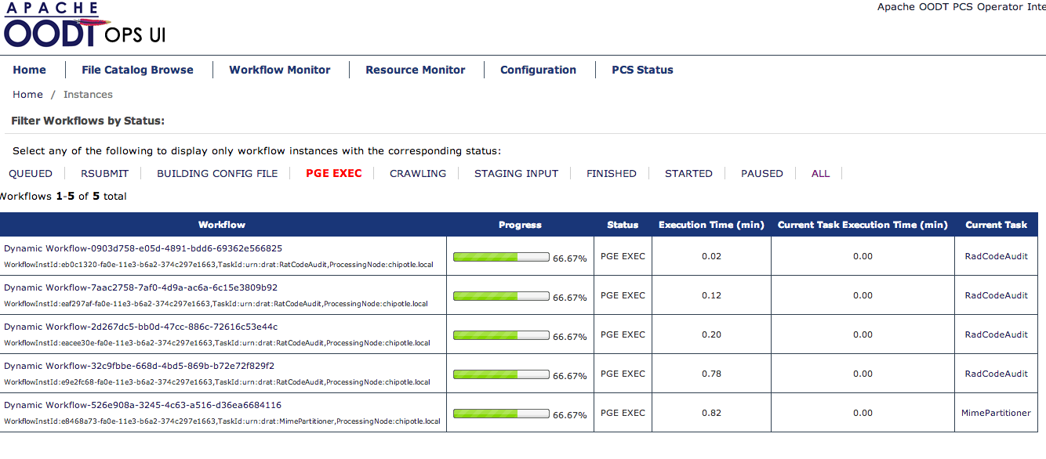
Running DRAT on CIG and PIHM
PIHM finishes in seconds, whereas CIG completes in ~33 hours

Slide 18
DRAT Conclusions
DRAT on all of CIG (500K files; likely 100s of M of LOC) was around 33 hrs. This is nearly 16x as long as it took to run DRAT on the entire XNET Git for DARPA (~24K files, and likely 10s of M of LOC).
DRAT scales linearly in the size of the code base.
CIG's analysis shows that over 54% of the CIG code base as put up on the CIG site are NOT code files (these could be images, they could be binary files, etc.) Of the remaining 46%, 23% of the files are unlicensed source code, and the other ~23% of the files are licensed using standards (BSD, MIT, OSI approved licenses).
roughly half of the *actual* source code for CIG isn’t licensed using an OSI approved license, and/or does not conform to stated license.
Considering the size disparity of e.g., PIHM compared to CIG, DRAT was able to correctly identify that 100% of the files in PIHM are unlicensed, whereas in CIG 50% of them (per above) were also not licensed.
demonstrates the need to approach these code authors and get them to use TurboSoft to publish their license information and then further to run DRAT as a component of this

Slide 19
Overall conclusions
Need to validate and verify software licenses
Existing tools do not scale well
Having viral licenses can mean the difference in having a community around your software and funding, or not
DRAT can help you run license checking at scale
Using Map Reduce
Scales linearly with the size of the code base
Running DRAT to date has already provided key results to Earth Science and defense communities

Slide 20
Thanks!
Chris Mattmann @chrismattmann on Twitter!

